Slide 1
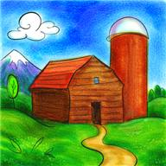
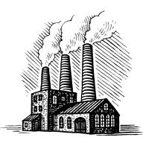
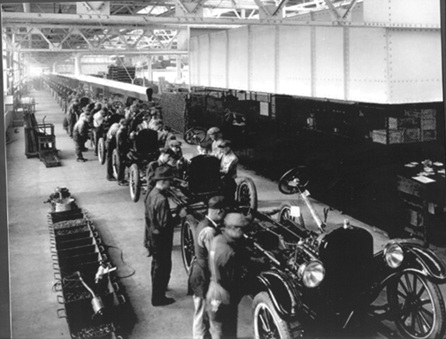
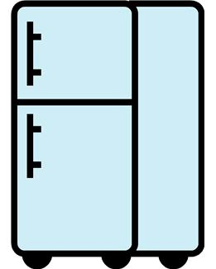
An increase in employment in industry versus decline in agriculture.
✓
The growth / boom of industries that supplied the raw materials (iron, steel, petroleum, plastics) for factories.
MASS PRODUCTION =
the manufacture and assembly of large amounts of standardised products on an assembly line containing many workers.
Manufacturing line at The Ford Motor Company
Allows goods to be made more quickly.
Allows goods to be made more cheaply.
Many more goods become available
Prices go down.
$$$$
People desire the goods they see.
Companies make a profit that they re-invest in their businesses.
Goods become affordable.
People spend their money on goods.

